Slide 1


eduVPN
Safe and Trusted
Rogier Spoor, SURFnet
François Kooman, DeiC
Tangui Coulouarn, DeiC
NTW19, Kastrup, 24 September 2019

Slide 2
Agenda
Short on eduVPN
What has been done in the last few months
eduVPN service aspects
Policy questions
eduVPN in production: the example of SURFnet
eduVPN technical aspects
Setting up eduVPN in 7 minutes
SAML

Slide 3

Why do we need eduVPN?
Working away from the office is the norm - Hotels, Cafés, Airports and Train Stations are the new offices
“How can I get WiFi?” is often the first question when attending meetings outside the office
BUT not all WiFi is born equal….
While eduroam is a secure environment with authenticated access and local encryption many public WiFi services are not
Unsecured hotspots
Shared access passwords
“Free” WiFi with web login screens
Are our users (and their data) safe?

Slide 4
The Risks of public WiFi
For Users
Unprotected WiFi can expose usernames and passwords
Content filtering on public WiFi may deny access to sites
Possibility of malware injection
Unknown and untrusted proxies could redirect users to fraudulent sites
For IT Support
Managed devices can insecurely connect to unknown networks
Risk of data loss
Ad-hoc, unmanaged VPN solutions may proliferate

Slide 5





eduVPN - securing access for remote users
eduVPN provides easy-to-use client software and a secure gateway to authenticate users and encrypt data.
Private
Connectivity
Public Internet
R&E Backbone
User authentication via eduGAIN
Secure VLAN
Connection
Insecure public Wi-Fi
Authenticated &
Encrypted Connection
eduVPN Gateway
Institution Network
Notes:
eduVPN provides a managed gateway and access software to protect the connection between the user and internet. Connection through to the institution can then take place through a trusted connection
Access to the internet can be directly from the eduVPN gateway or via the institutional network to enable access monitoring and control (if required)

Slide 6
The 2 uses of eduVPN
Secure Internet: eduVPN instance gives access to the public Internet.
Possibility for guest access
Possibility for filtering for undesired traffic, services or content (e.g. add-free profile implemented in Germany)
Privacy and security enhancing
Institute access: eduVPN gives access to private resources
Stand-alone implementation
Managed service
Possibility for strong authentication
Profiles for different users/groups

Slide 7
Open-Source VPN software comparison
Product | Technology | Scalable | Encryption | Audit | Hide traffic | Rebrandable apps | Enterprise Identity
Algo | IPsec & IKEv2 | Personal or small scale | Modest - Good | No | no | no | no
WireGuard | WireGuard | Protocol supports CPU scaling | State of the Art | Formal verification | no | Yes | no
PPTP | PPTP | Not really | Bad | yes | no | no | no
SoftEther | Various | Large scale/enterprise | Modest - Good | Fuzzing | yes | yes | no
OpenVPN 2.x | OpenVPN 2.x | Personal or small scale | Modest - Good | Yes, various | yes | no | no
eduVPN - Let's Connect! | OpenVPN 2.x | Large scale/enterprise | Good | Clients and Server | yes | Yes | yes, SAML
OpenConnect | AnyConnect | Large scale/enterprise | Modest - Good | Unknown | yes | Yes | Work in Progress

Slide 8
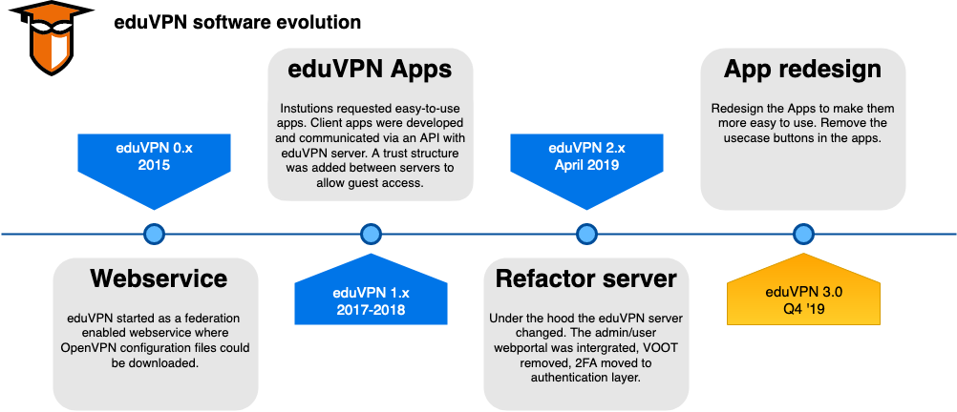

Slide 9
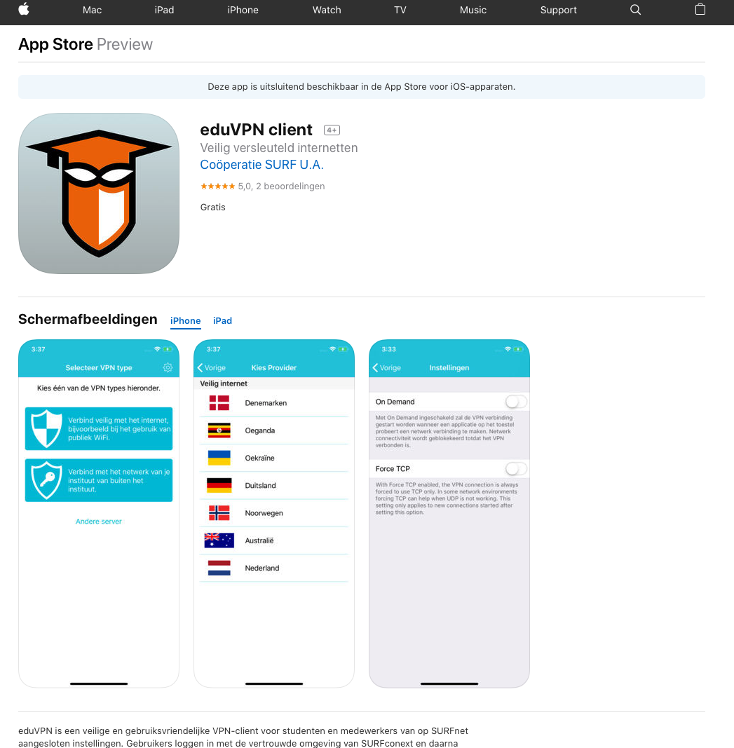
Audited apps for different platforms
iOS
MacOS
Windows
Android
Linux
All eduVPN software approved by GÉANT Dec ’18

Slide 10
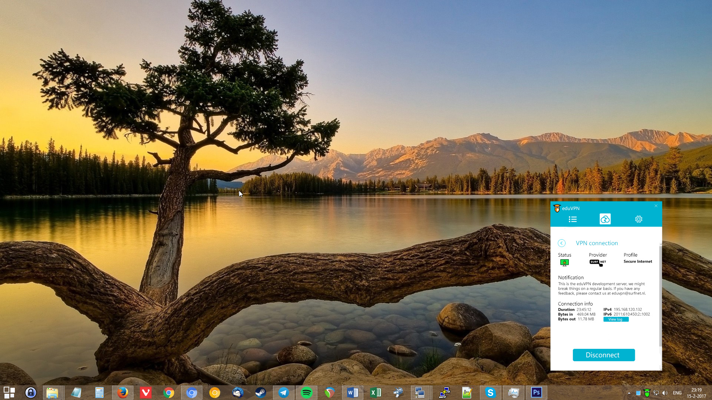
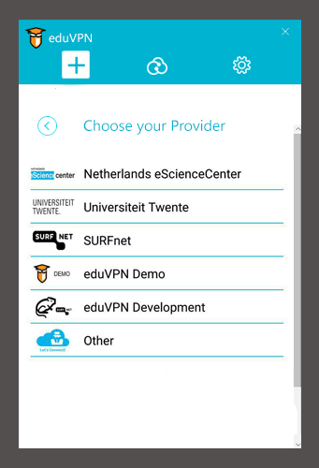
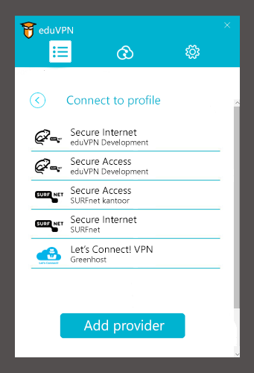
Three Steps to Safety
Step 1 Select Your Organisation
Step 2 Choose a Profile
Step 3 Ready to Go

Slide 11
How is secure internet implemented?
NREN implementation
Each participating NREN offers a gateway to their participating institutions
GÉANT Project co-ordinates development and standards
9/10 NRENs currently offering gateways
Holland, Denmark, Australia, Uganda, Ukraine, Norway, Germany, Pakistan, Finland, France

Slide 12
Policy for a federated service
The technical governance of eduVPN lies in the Commons Conservancy
The service governance is defined in a policy document
Inspired by eduroam
Largely up to national operators (NRENs) to ensure compliance in a country
Security and incident response obligations

Slide 13
Guest access and abuse redress in a privacy-by-design service
An eduVPN operator cannot identify a user alone
Abuse can be traced to pseudonym when eduVPN instance is using public IP addresses
Pseudonym -> person requires collaboration of the originating NREN/IdP

Slide 14
eduVPN Institute Access as a stand-alone instance
Institute deploys eduVPN on their own, signs the policy and asks to be included in the apps
Model adopted e.g. by:
Tampere Universities
Silesian University of Technology Computer Centre
Sometimes confusion regarding support
Interesting dialogue with institutions regarding features

Slide 15
eduVPN Institute Access as a Managed Service
Model currently implemented in the Netherlands
eduVPN instance managed centrally by SURFnet
Lightpath back to the private resource
Support by SURFnet
No need for hardware on campus or licensing limitations

Slide 17




D4S project started on 1st September 2019
New apps UI -> easier to use for non-tech users
Collaboration between:
DTU
the Royal Danish Academy of Fine Arts, School of Design
Commons Caretakers
Project funded by NGI_Trust 1st Open Call

Slide 18

eduVPN programme of the Commons Conservancy
Home of the technical governance
Continuous work on WireGuard support
Contribution through funding and code
Collaboration with Phil Zimmermann on overall design for integration in eduVPN
Investigate other use cases, like server mesh

Slide 19
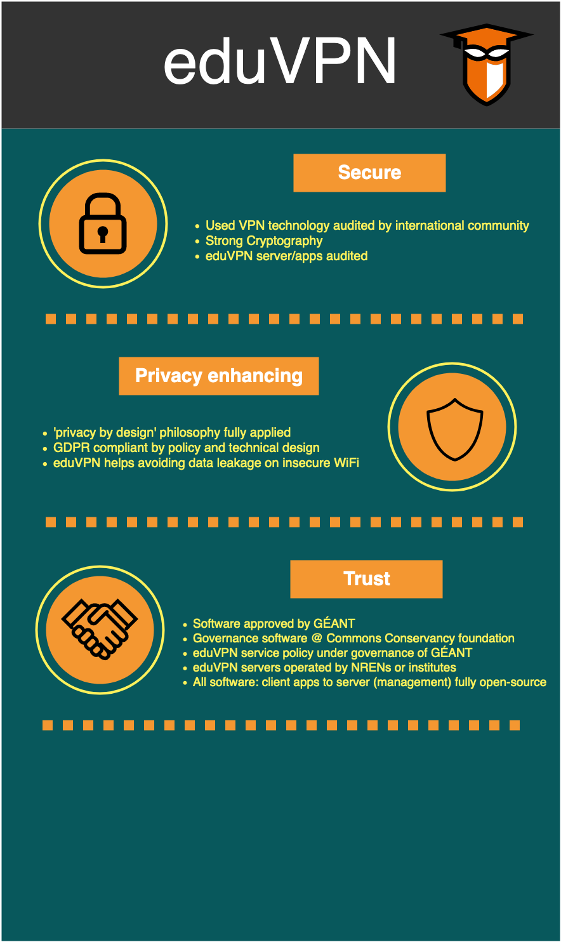

Slide 20
Contact
Email: eduvpn-support@lists.geant.org

